Slide 1
DIRECTIONS: Read the article out loud—please be helpful and volunteer!!! ☺

Slide 2
DIRECTIONS: Do this practice individually. Then, go over it.

Slide 3
DIRECTIONS: In considering truth in advertising, consider how visuals either enhance or flat out manipulate perceptions of products, their effects, etc.

Slide 4
DIRECTIONS: Jot down ideas on your answer sheet. Then share ideas as a whole class. Be helpful, and volunteer please . ☺

Slide 5
DIRECTIONS: Volunteer ideas about what you notice as different in the before and after and how that is fair enhancement or total manipulation.

Slide 6
DIRECTIONS: Jot down ideas on your answer sheet. Then share aloud.

Slide 7
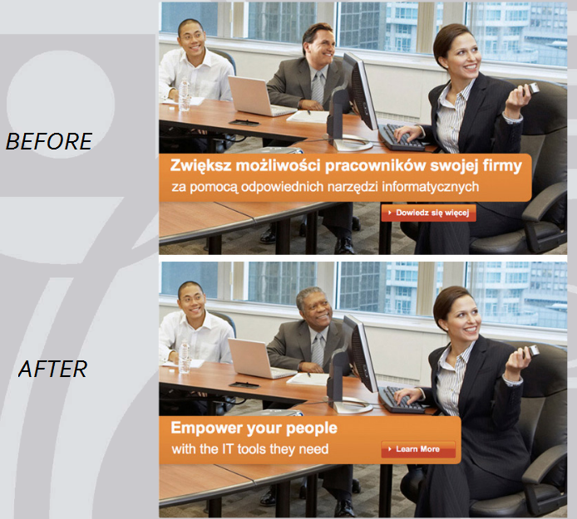
DIRECTIONS: Share ideas: Is Microsoft catering to audience? Being racist?
Ad published in Poland.
Ad revised for the US.

Slide 8
DIRECTIONS: Jot down ideas on answer sheet. Then share aloud.

Slide 9
Did you talk about population???
In India there are over 1.2 billion people…

Slide 10
DIRECTIONS:
Share aloud ideas about the changes in the before vs. after. What has Ford done to enhance the appearance of the car?

Slide 11
DIRECTIONS: Jot down notes on your answer sheet, then share aloud.

Slide 12
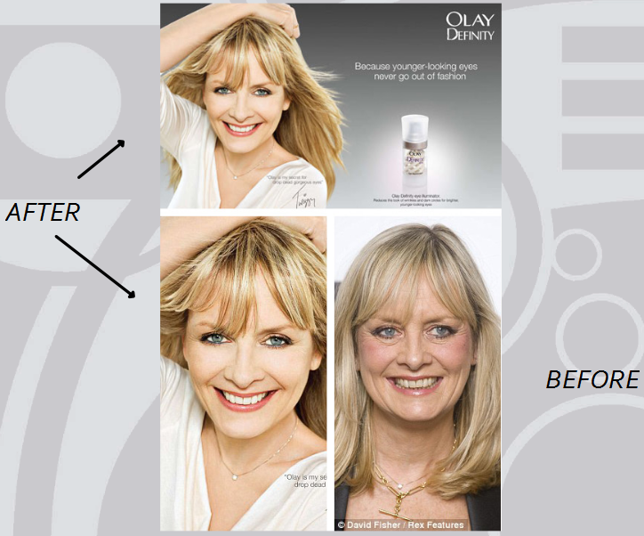
DIRECTIONS: Share aloud observations about the before and after. Is this fair? Wrong? Potentially dangerous?

Slide 13
We’re skipping the Redbook one. Just advance to the next slide for a closing activity.

Slide 14
DIRECTIONS: In your groups, construct a response to address the following prompt:

